Slide 1
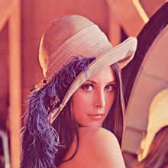
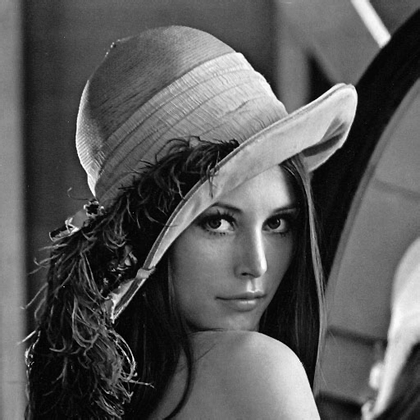
Machine Learning Image Processing Using Python
Team Member - Sumit Sharma (10501947) Jeet Udaiyar (10514319) Amit Goud (10505896)

Slide 2
Objective
Image
Image Processing
Image formation
Purpose of Image Processing
Types of Image Processing
Python
Environment
Requirement & Installation
Packages & OpenCv
Image Processing - Flow Diagram
Demo
Future Use
References

Slide 3
What is Image ?
An image is a visual representation of something.
It is replicated and put away in an electronic structure.
A picture can be depicted in wording of vector graphics or raster designs.

Slide 4
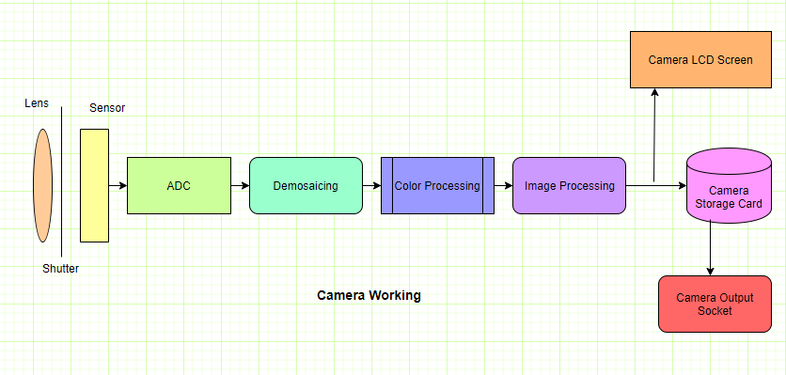
Image Formation

Slide 5
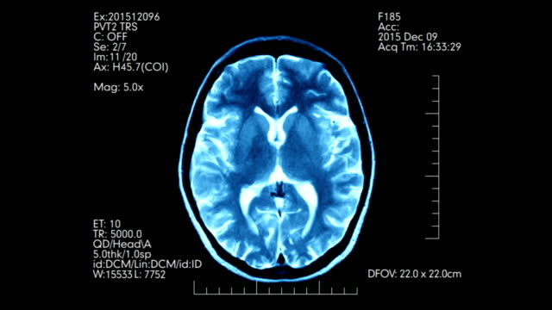
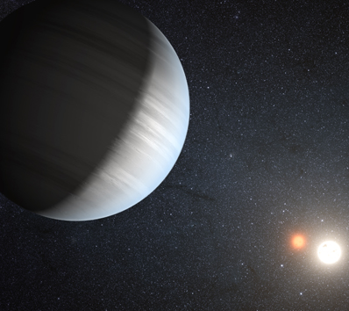


Image Processing

Slide 6
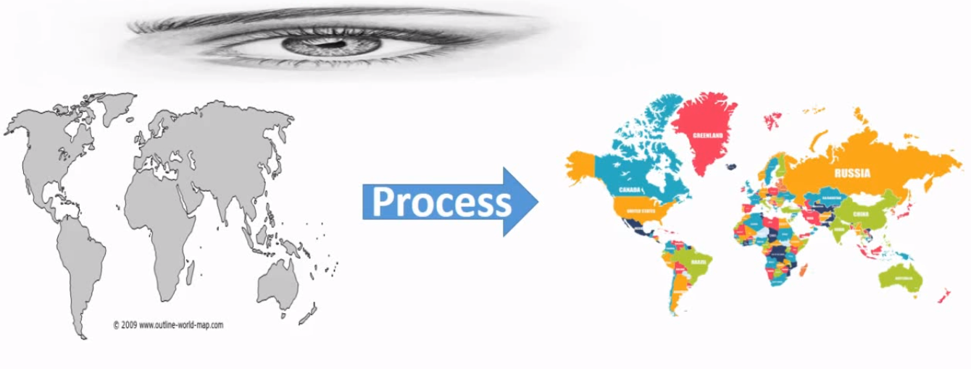
Image Processing

Slide 7
Image Processing
Analysis and manipulation of a digitized image
Method to perform some operations on an image
It is a kind of sign handling where information is a picture and yield might be picture or attributes/highlights related with that picture.
Picture preparing fundamentally incorporates the accompanying three stages:
- Importing the picture by means of picture obtaining devices.
- Analyzing and controlling the picture.
- Output in which result can be adjusted picture or report that is based on picture investigation.

Slide 8
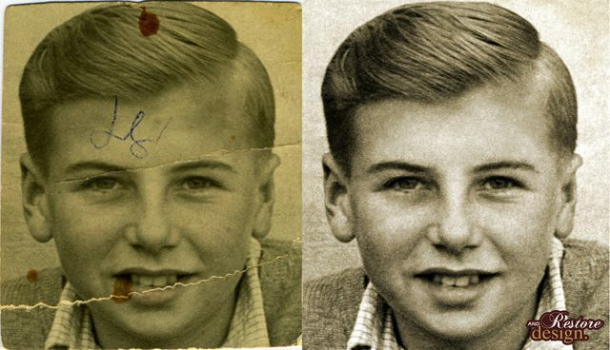
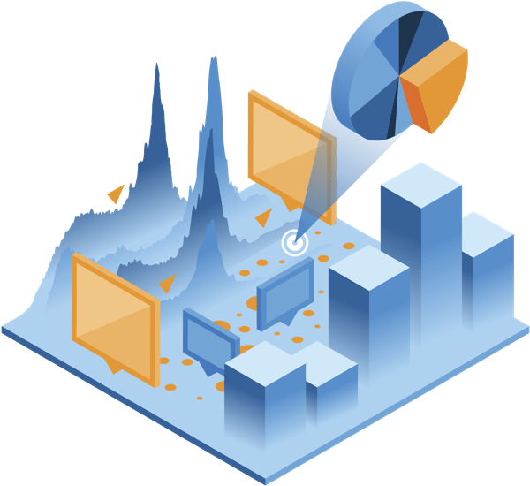
Purpose of Image Processing
The reason for picture handling is isolated into 5 gatherings.
They are:
1. Visualization - Observe the articles that are not noticeable.
2. Image honing and rebuilding - To make a superior picture.
3. Image recovery - Seek for the picture of intrigue.
4. Measurement of example – Measures different items in a picture.
5. Image Recognition – Distinguish the items in a picture.

Slide 9
Types of Image Processing
The two kinds of methods utilized for Image Processing are Analog and Digital Image Processing.
Simple or visual systems of picture preparing can be utilized for the printed versions like printouts and photos.
Pictorial representation of the information spoke to in simple wave designs that can be named as simple picture. E.g.: TV broadcasting in more seasoned days.
Advanced Processing procedures help in the control of the computerized pictures by utilizing PCs.
The three general stages that a wide range of information need to experience while utilizing the advanced system are
-Pre- processing,
-Enhancement and display,
-Information extraction.

Slide 10
What is python?
Python is an open source programming language.
Easy-to-read and powerful.
Python is an object-oriented programming language.
General-purpose programming language
Used for programming,
-Web development
-Scientific computations
-data science.
For latter, several python packages are used,
-including NumPy
-SciPy
-Matplotlib

Slide 11
Python Environment
Anaconda is an open source python (and R) distribution.
Provides the python interpreter, together with a list of python packages
Most widely used tools for data science applications.
Implementing the algorithm to visualization to reproducible research.
Jupyter Notebook is an open-source web application
Allows you to create and share documents that contain live code, equations, visualizations and explanatory text.
Uses include data cleaning and transformation, numerical simulation, statistical modeling, machine learning and much more.

Slide 12
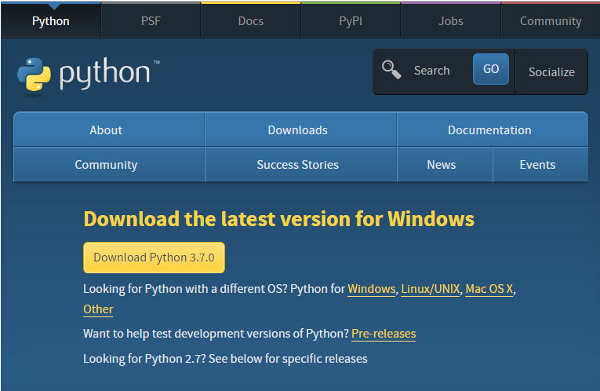
Python Installation
Click Python Download.
https://www.python.org/downloads/
Snap the Download Python 3.7.0 button. The record named python-3.7.0.exe should begin downloading into your standard download organizer. This record is around 30 Mb so it may require a long time to download completely in the event that you are on a moderate web association (it took me around 10 seconds over a link modem).
Move this record to an increasingly changeless area, so you can introduce Python (and reinstall it effectively later, if vital).
Don't hesitate to investigate this page further; on the off chance that you need to simply proceed with the establishment, you can end the tab perusing this website page.
Begin the Installing instructions legitimately beneath.

Slide 13
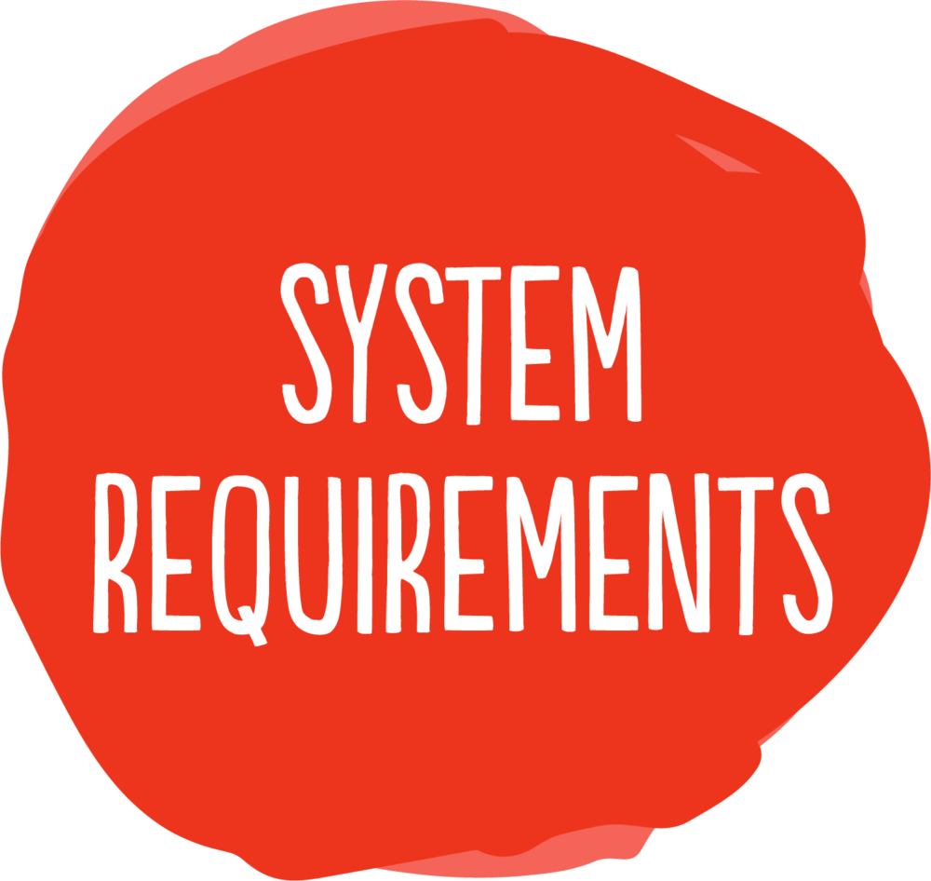
Python : System Requirements
Processors: Intel® Core™ i5 processor 4300M at 2.60 GHz or 2.59 GHz (1 socket, 2 cores, 2 threads per core), 8 GB of DRAM. ...
Disk space: 2 to 3 GB.
Operating systems: Windows® 10, macOS*, and Linux*

Slide 14
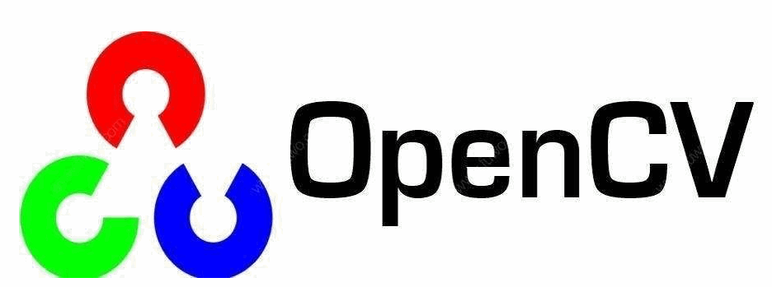

Python Packages
A package is a hierarchical file directory structure that defines a single Python application environment that consists of modules and sub packages and sub-sub packages, and so on.
Packages mostly used OpenCv and we have implemented as well using this package.
OpenCV
Open CV-Python is a library of Python bindings designed to solve computer vision problems. OpenCV-Python makes use of NumPy, which is a highly optimized library for numerical operations with a MATLAB-style syntax.
All the OpenCV array structures are converted to and from NumPy arrays.

Slide 15
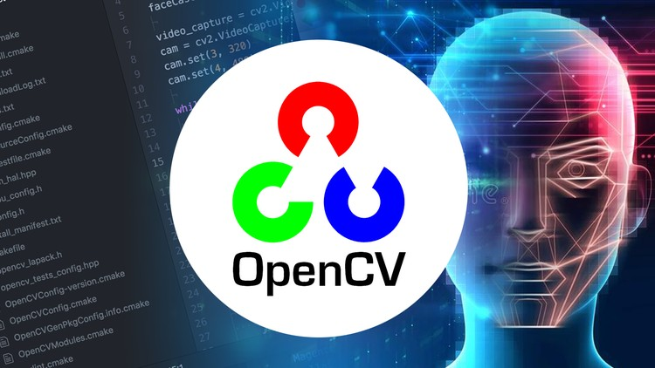
Building Opencv

Slide 16
What is open cv?
OPEN SOURCE COMPUTER VISION LIBRARY.
BUILD TO PROVIDE COMMON INFRASTRUCTURE FOR COMPUTER VISION APPLICATION.
ACCELERATE THE USE OF MACHINE PERCEPTION IN THE COMMERCIAL PRODUCTS.
INCLUDES MORE THAN 2500 OPTIMIZED ALGORITHMS.
RECOGNIZING FACE, IDENTIFING OBJECTS, CLASSIFY HUMAN ACTIONS IN VEDIOS, TRACKING CAMERA MOVEMENTS.

Slide 17
Types of OpenCV
Types of OpenCV
1.cv
All the OpenCV data types are preserved.
Image format in cv are in cvMat.
For array operation function cvSet2D & cvGet2D are used.
2. cv2
This is the latest type of OpenCV.
Everything here are returned as NumPy and Python objects.
ndarray and native are Numpy objects.
lists, tuples, dictionary are Python objects.

Slide 18
Installation of opencv
For windows, macOS, Linux
Run *pip install opencv-python* if you need only main modules.
Run *pip install opencv-contrib-python* if you need both main and contrib modules.
For headless environment
Run *pip install opencv-python-headless* if you need only main modules.
Run *pip install opencv-contrib-python-headless* if you need both main and contrib modules.

Slide 19
Supported python version
Python 2.7
Python 3.4
Python 3.5
Python 3.6
Python 3.7

Slide 20
Demo Description
Here, we are going to show an demo.
In this we are going to implement image processing.
First step to extract an image into the python.
Further taking this input image(RGB color) we have filter that image using OpenCV package.
The output will be an grayscale image.
Benefits of Grayscale image.

Slide 21
Demo - Flow diagram
Retrieving Image
Image Processing (Filtering the Input Image)
Image
Converting the Input image into Grayscale image
Writing the Grayscale image into a new folder

Slide 22
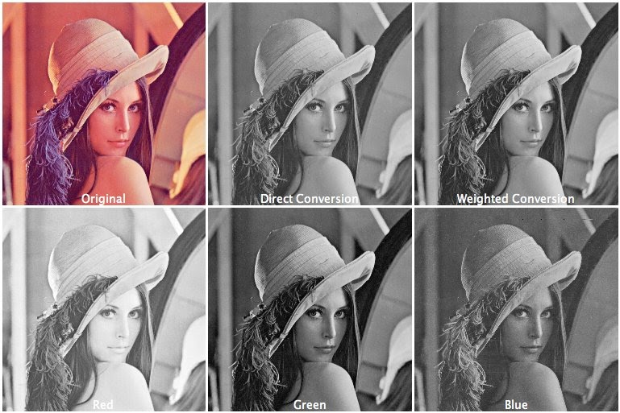
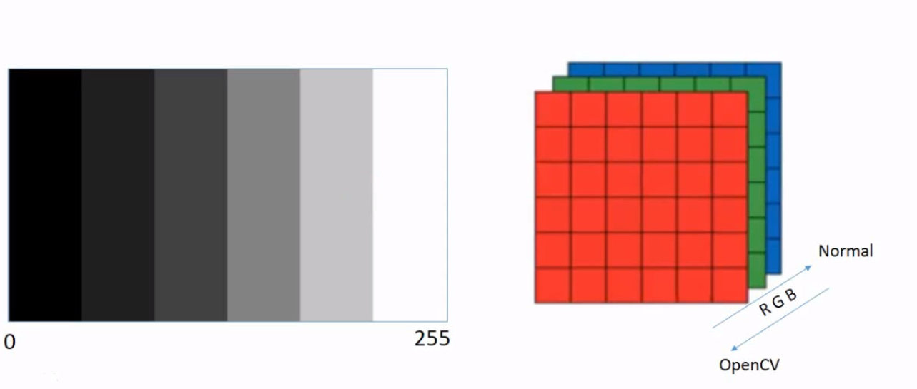
Grayscale Images
single intensity value for each pixel.
8-bit integer giving 256 possible different shades.
grayscale images are entirely sufficient for many tasks.

Slide 23
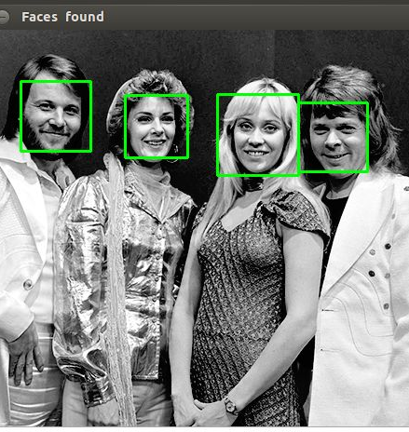

Usages
Face detection is a computer technology.
Grayscale image can be use for face detection.
Face detection algorithm.
Real Time Face Recognition.
FaceMatch.
Android Face Recognition.

Slide 24
References
https://whatis.techtarget.com/definition/image
https://stackoverflow.com/questions/10417108/what-is-different-between-all-these-opencv-python-interfaces
https://pypi.org/project/opencv-python/
https://www.engineersgarage.com/articles/image-processing-tutorial-applications

Slide 25
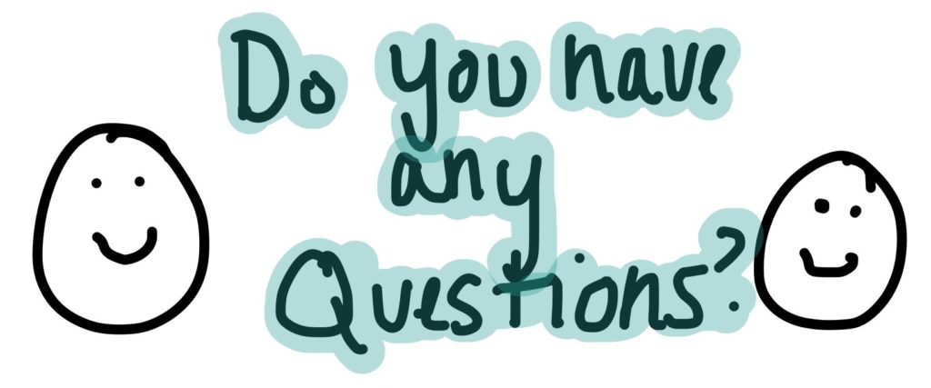

Slide 26

Thank you

